Slide 1
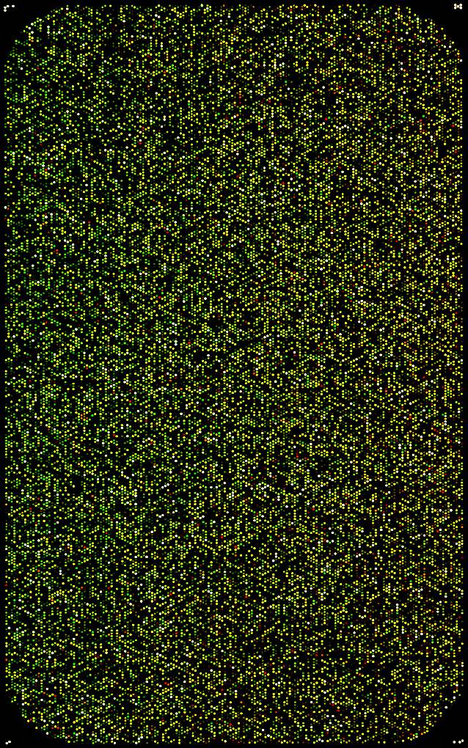
Main idea
Microarrays contain information, but not only.
People generally apply filters before analyzing data.
(1)
(2)
Multiple hypothesis testing.
Reduce the variable (probes) space.
Informative
Non informative

Slide 2
‘State of the art’
Commonly used methods:
Probes for which at least p% of samples have a signal > threshold
Mean of signal > threshold
Variance of signal > threshold
Methods combining mean and variance (Marczyk et al. Bioinformatics 2013)
Bayesian approach (Talloen et al. Bioinformatics 2007, FARMS R package)
Principal Components Analysis (loadings)

Slide 3
Original Idea
PCA on samples
xxxxxxxxxx
xxxxxxxxxx
xxxxxxxxxx
xxxxxxxxxx
….
xxxxxxxxxx
xxxxxxxxxx
PC2
PC1
What if…PCA on probes.
x
x
x
x
x
x
x
x
x
x
x
x
x
x
x
x
x
x
x
x
x
x
x
x
x
x
x
x
x
x
x
x
x
x
PCn+1
x
x
x
x
x
x
x
x
x
x
x
x
x
x
x
x
x
x
x
x
x
x
x
x
x
x
x
x
x
x
x
x
x
x
x
x
x
x
x
x
x
x
x
x
x
x
x
x
x
x
x
x
x
x
x
x
x
x
x
x
x
PCn

Slide 4
Lee dataset: lung, N = 138
- adenocarcinomas, n = 62
- squamous carcinomas, n = 76
- GEO: GSE8894, PMID: 19010856
- platform: Affymetrix U133 Plus 2.0

Slide 5
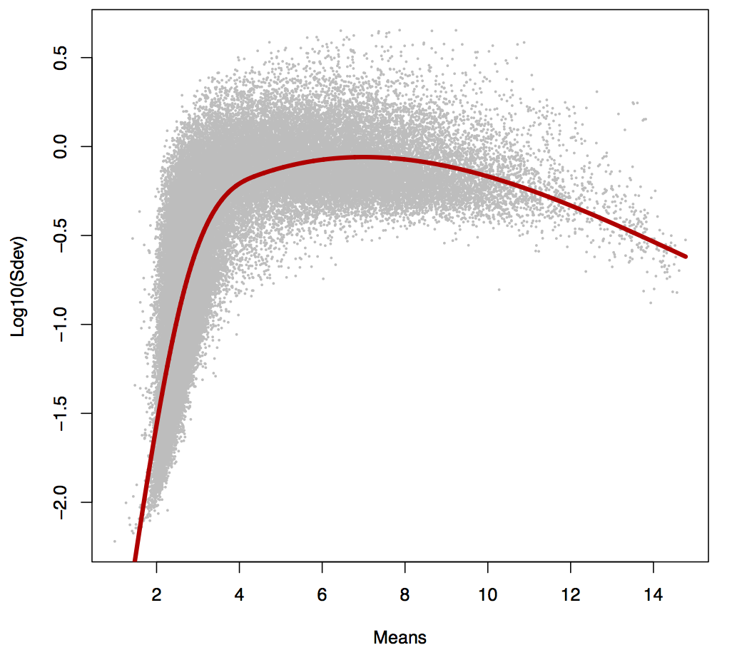
Standard deviations Vs. means (per probe)

Slide 6
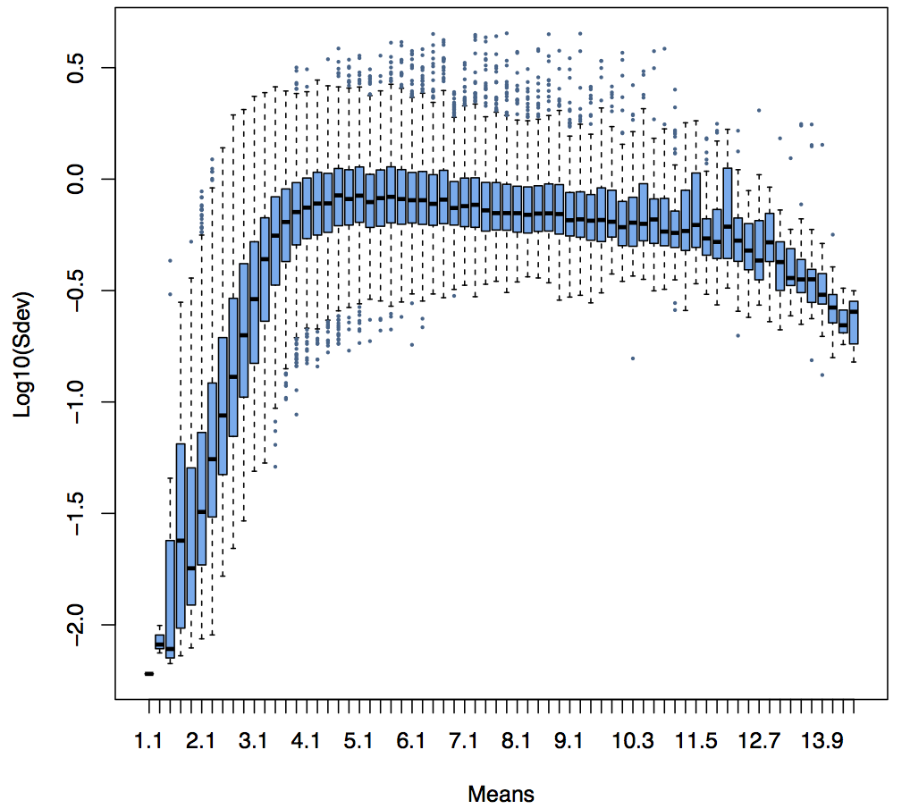
Adding some non informative probes
Eset
5000 ‘white’ probes
‘white’ probes

Slide 7
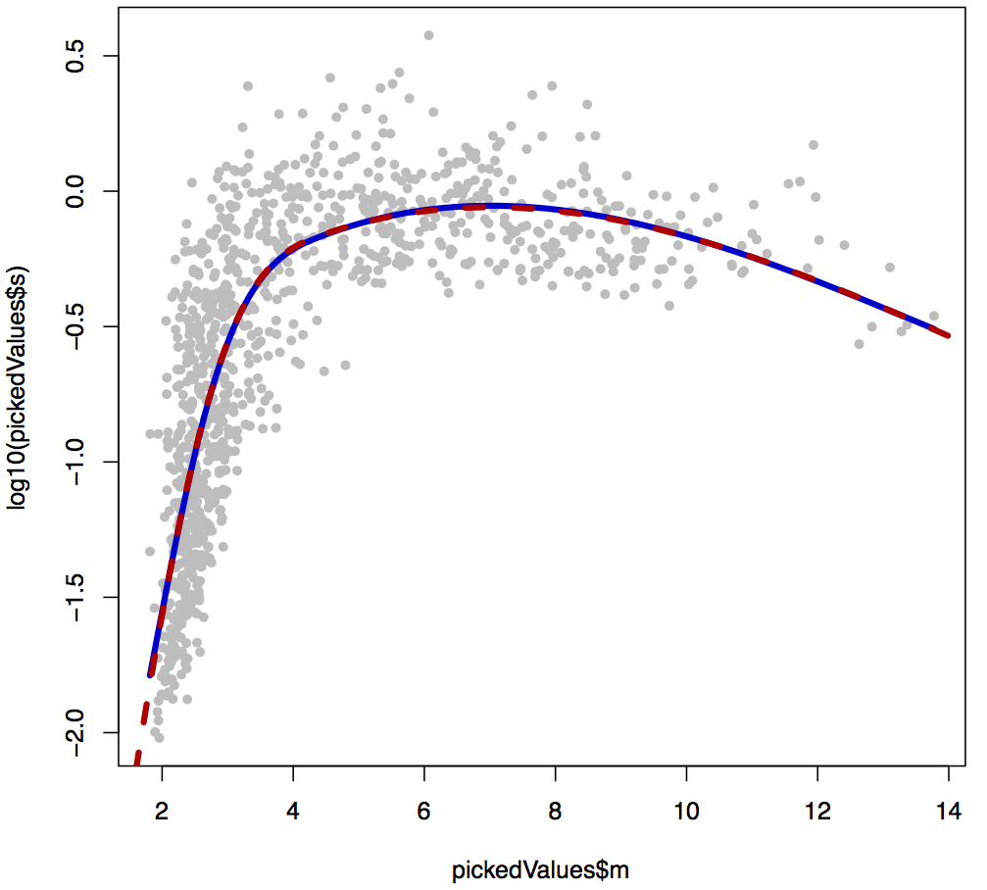
Standard deviations Vs. means (‘white’ probe)

Slide 8
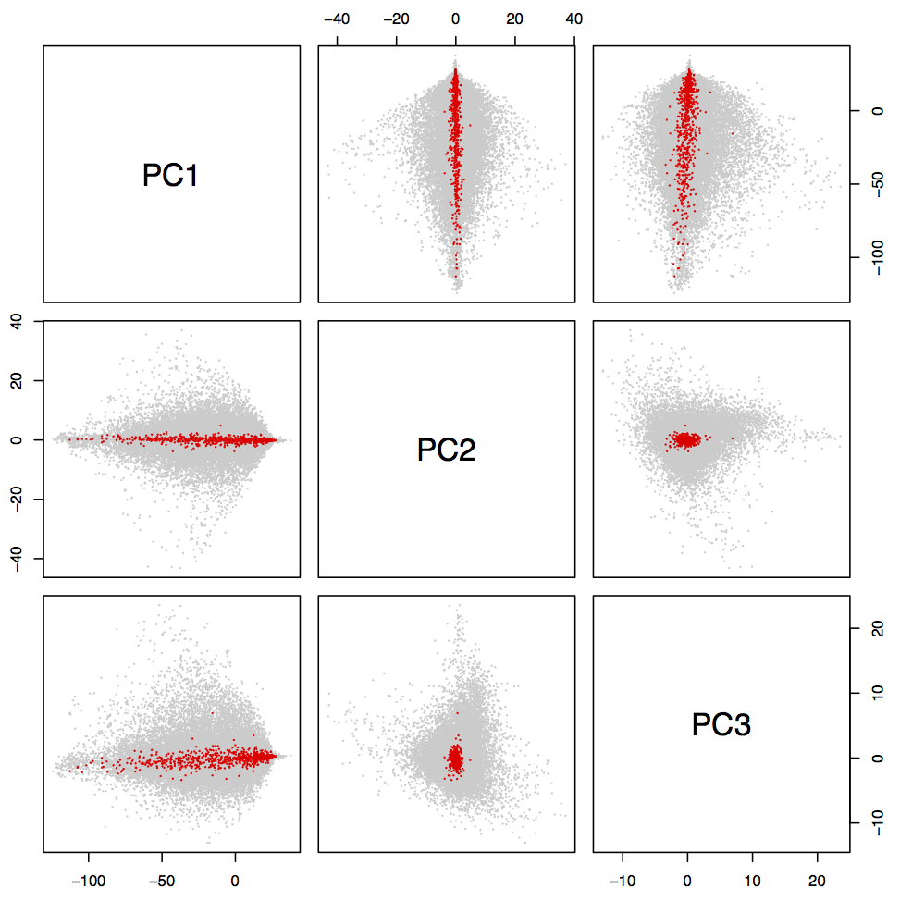
‘White’ probes location
‘White’ probes

Slide 9
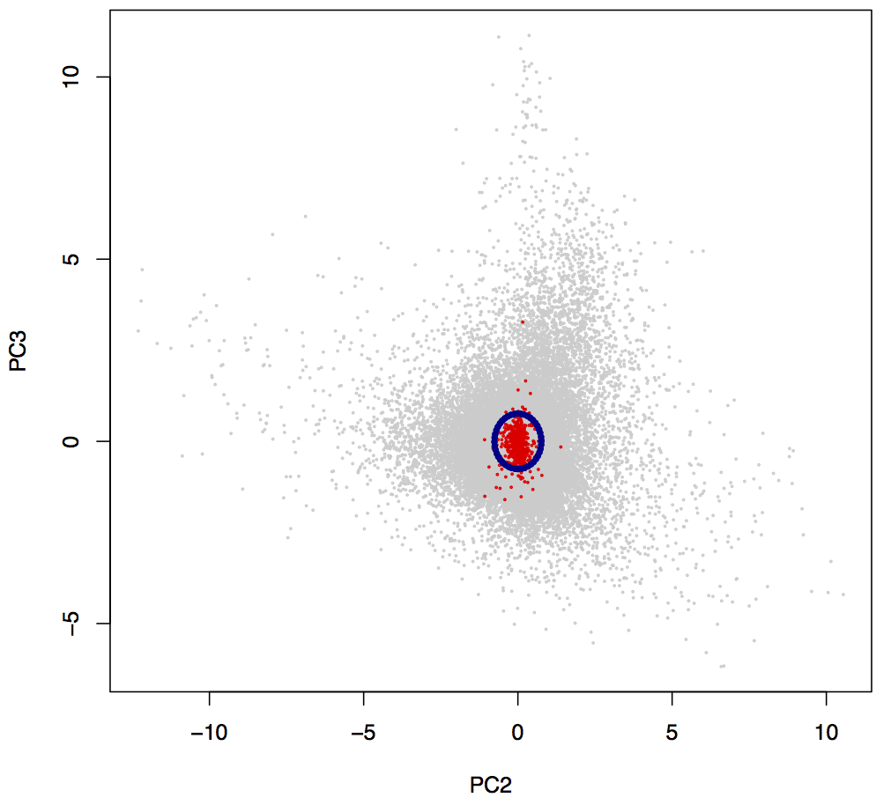
‘White’ probes threshold
‘White’ probes
q95 sqDist

Slide 10
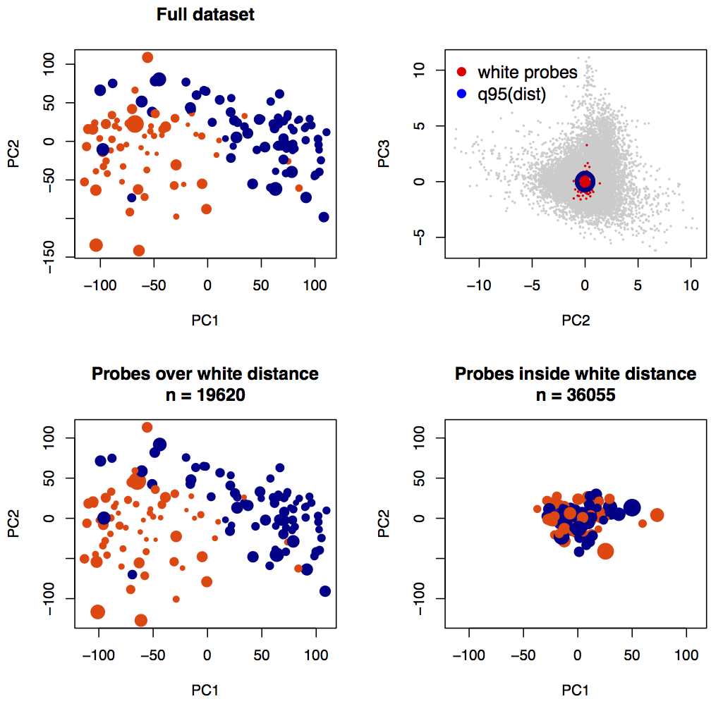
Informative probes selection

Slide 11
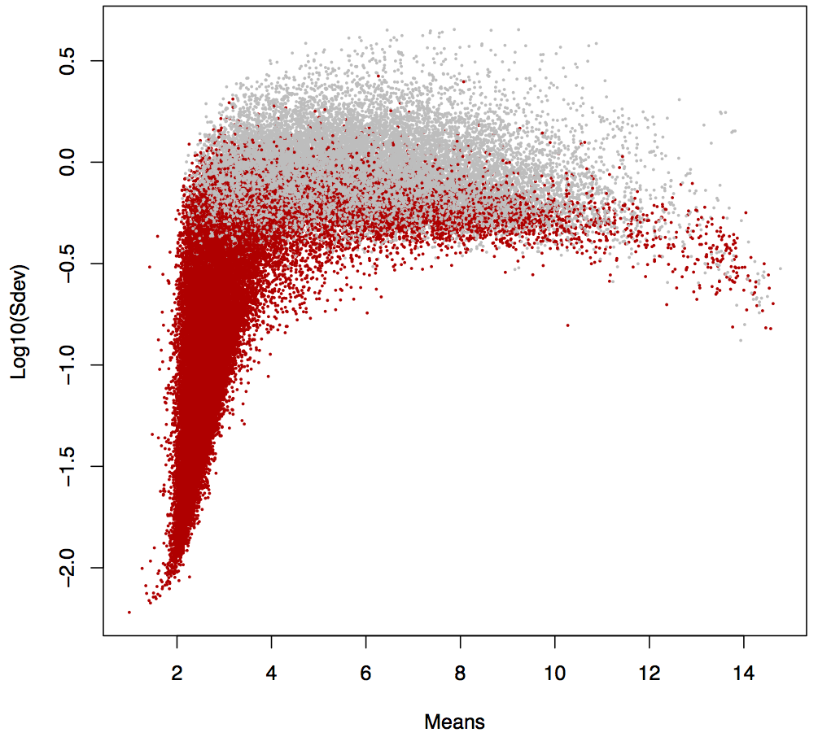
Non informative Sdev

Slide 12
ALL data set

Slide 13
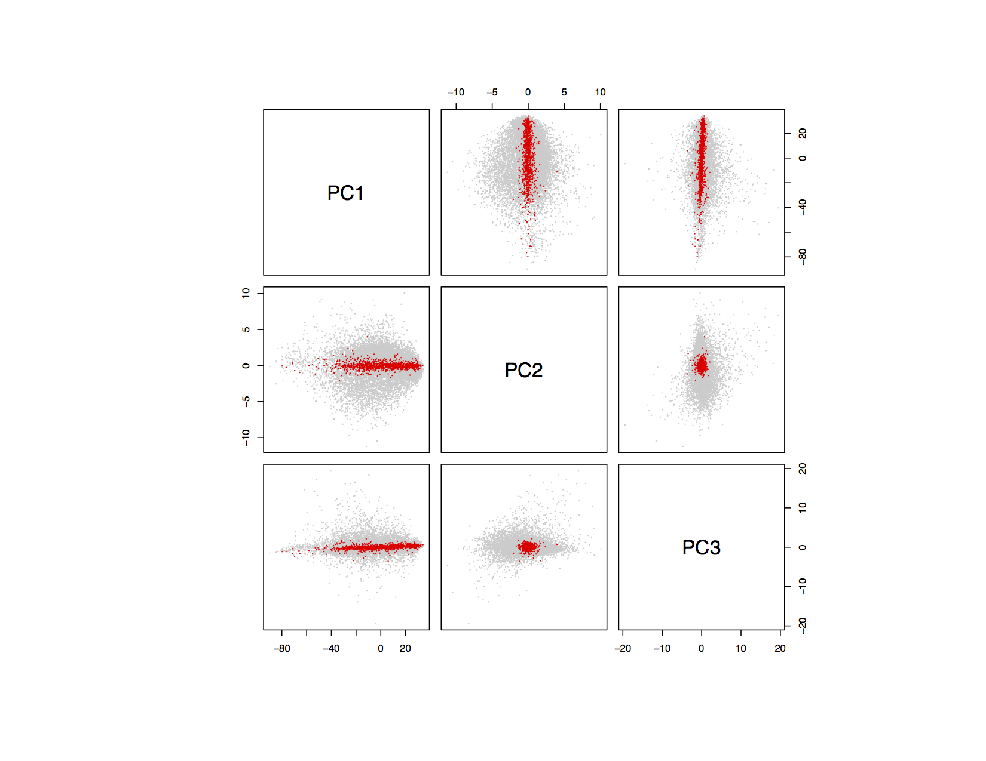
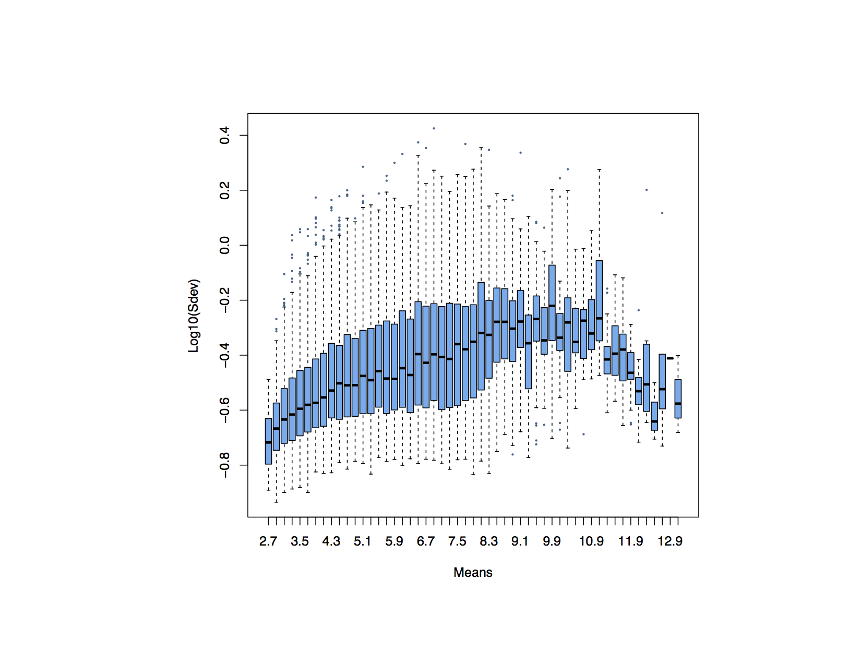
Adding some non informative probes

Slide 14
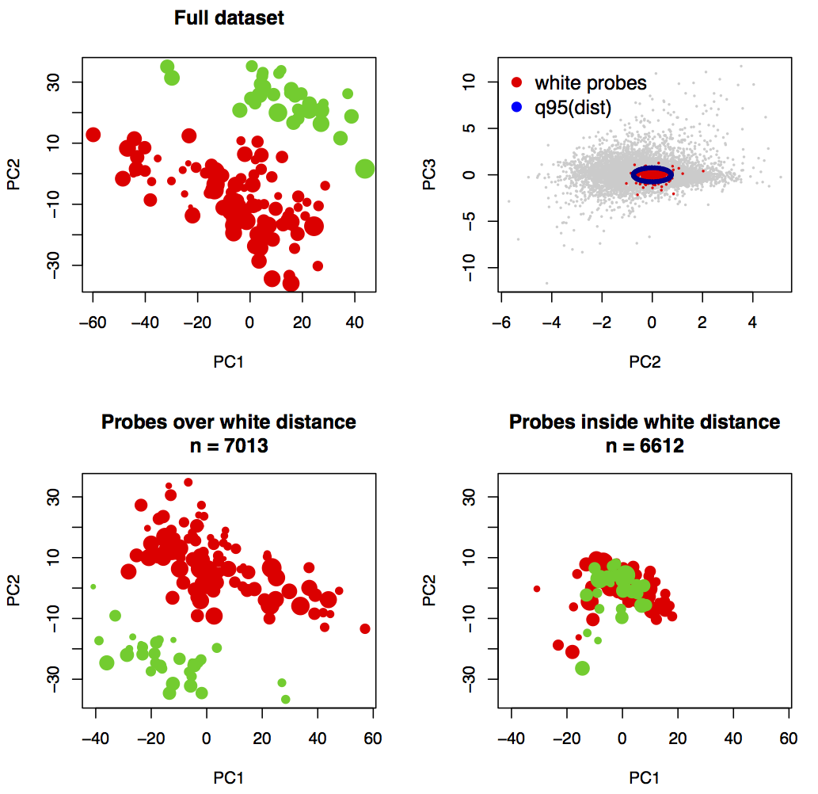
Informative probes selection

Slide 15
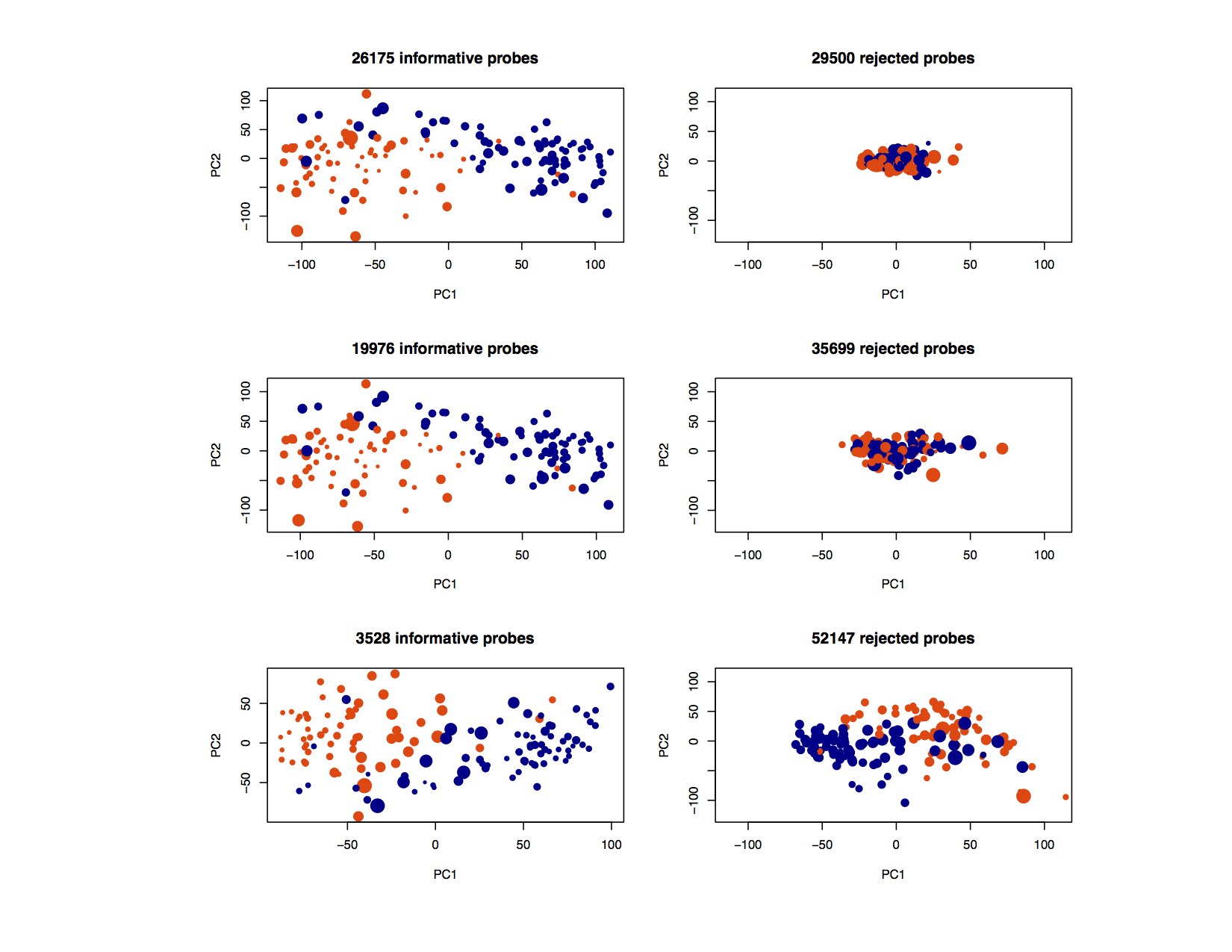
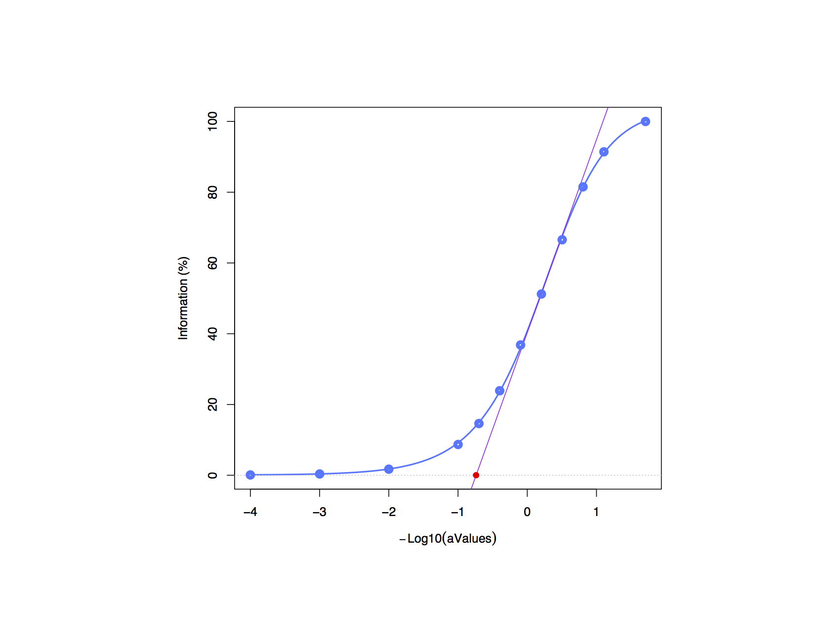
Using information curve
Lee data set

Slide 16
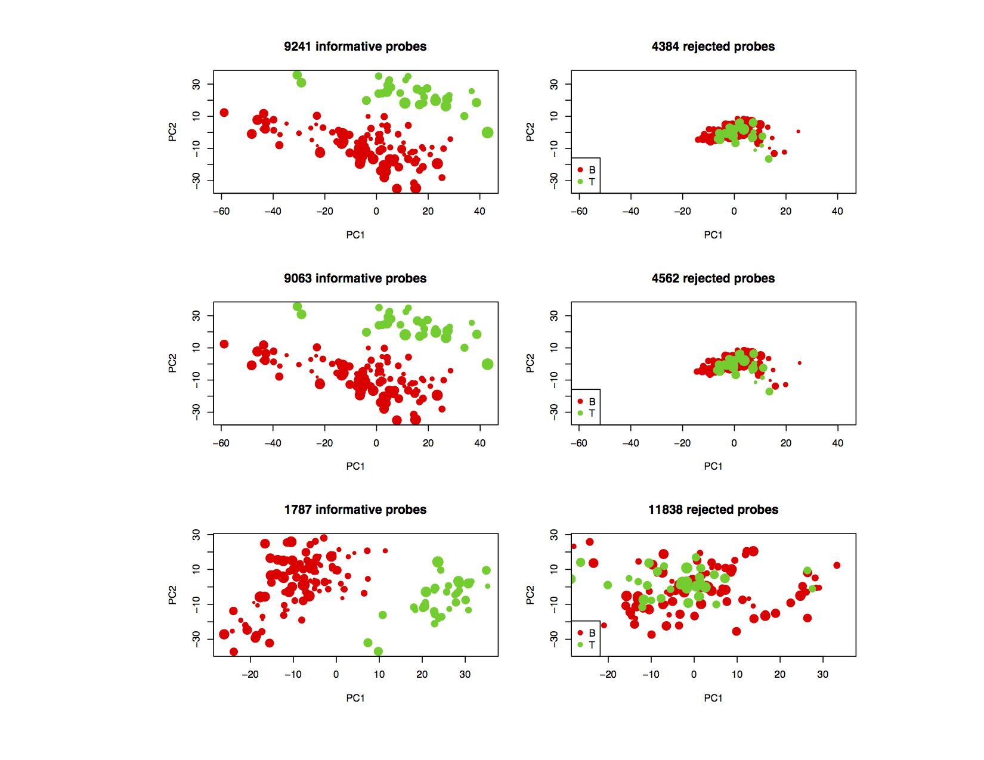
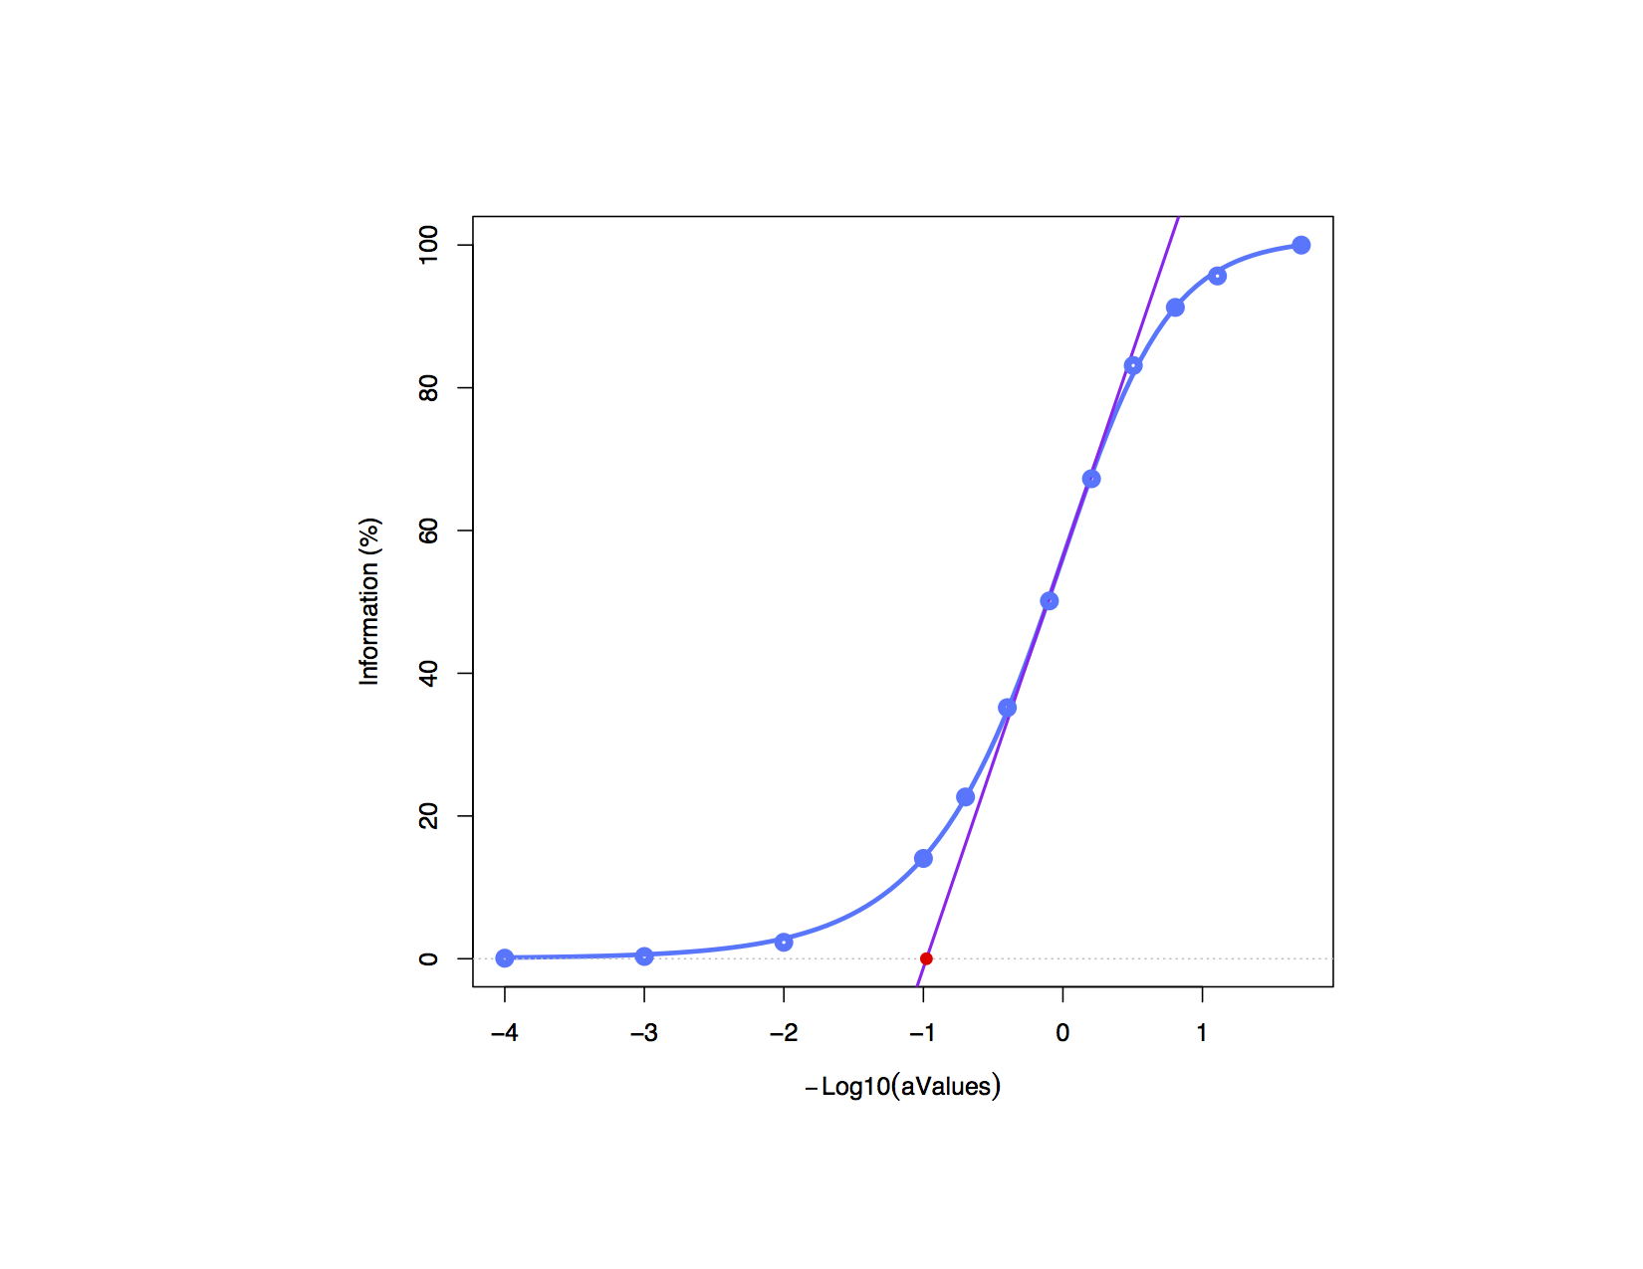
ALL data set

Slide 17
Simulations
Lee dataset: lung, N = 138
- adenocarcinomas, n = 62
- squamous carcinomas, n = 76
- GEO: GSE8894, PMID: 19010856
- platform: Affymetrix U133 Plus 2.0

Slide 18
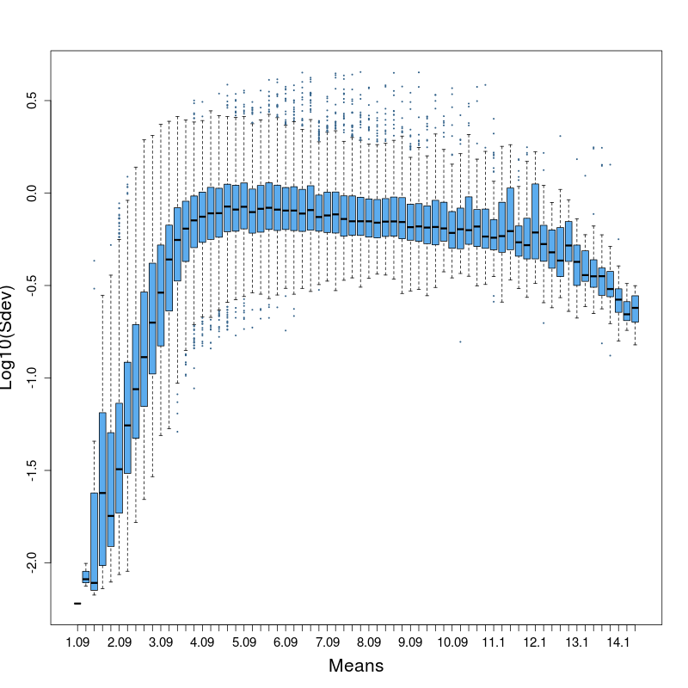
Log₁₀(Sdev) Vs. Means
Based on Lee data set

Slide 19
Adding simulated probes
Original data set
Probes simulation
2500 ‘white’ probes
‘white’ probes
500 ‘significant’ probes

Slide 20
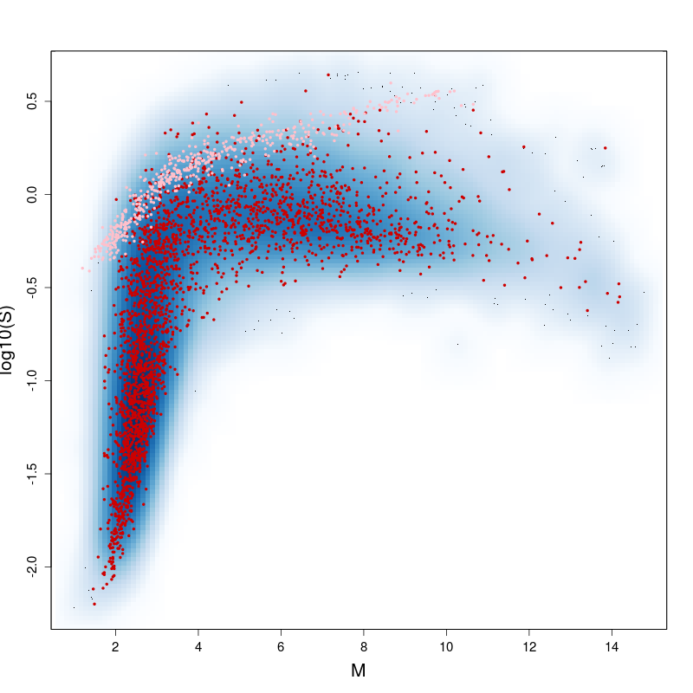
Simulated probes: Log₁₀(Sdev) Vs. Means
Real values
generated non significant probes
generated significant probes

Slide 21
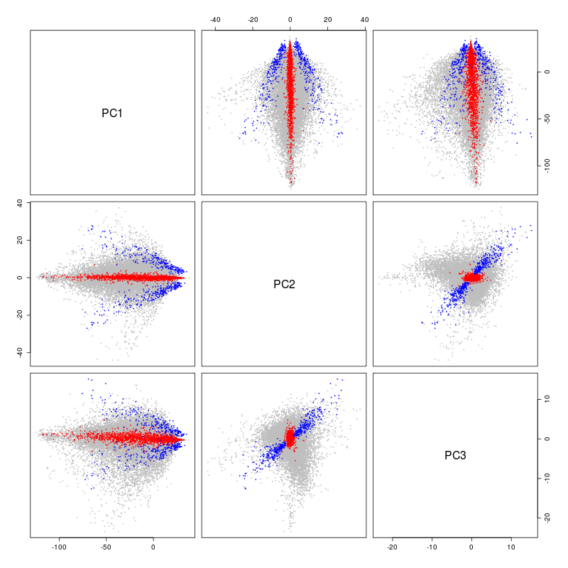
Simulated probes on PC axes
Real probes
Non significant generated probes
significant generated probes

Slide 22
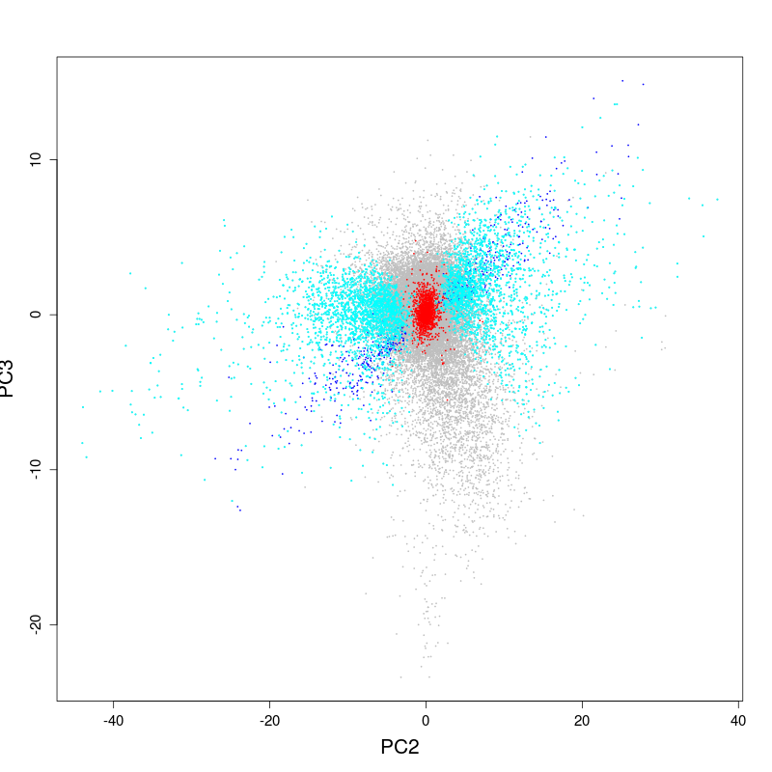
Differentially expressed probes on PC axes
Multiple testing procedure
Adenocarcinomas Vs. Squamous
Adjusted p-value ≤ 1e-2
4016 probes
(excluding generated probes)

Slide 23
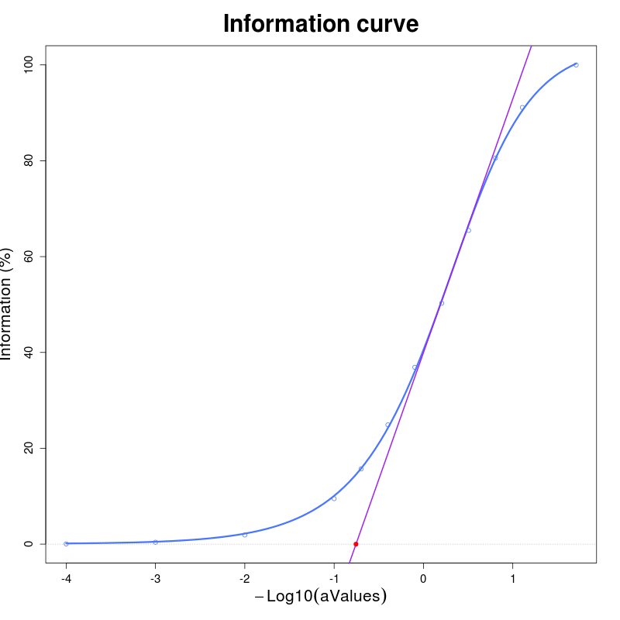
Using information curve
Information curve
Cut at 5%
30542 rejected probes (~ 53%)

Slide 24
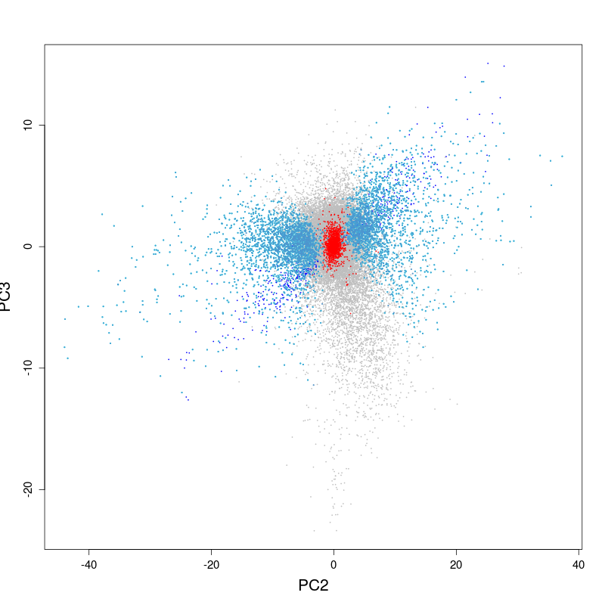
Post- filtering: Differentially expressed probes on PC axes
Multiple testing procedure
on 27133 filtered probes
Adenocarcinomas Vs. Squamous
Adjusted p-value ≤ 1e-2
4199 probes
(excluding generated probes)
Real probes
Non significant generated probes
True significant probes

Slide 25
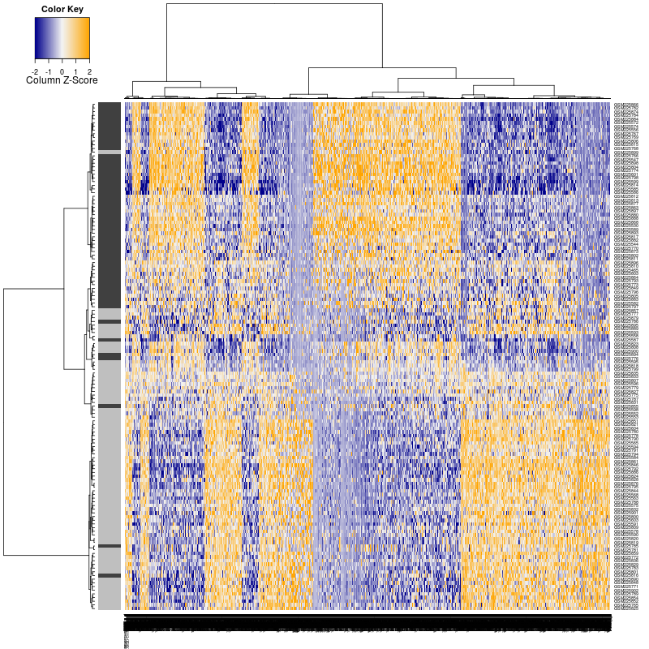
Heatmap of the tumor-type signature
Adk
Sqk

Slide 26
?
Non informatives
PC3
Discriminate
Adk Vs. Sq
???
PC2

Slide 27
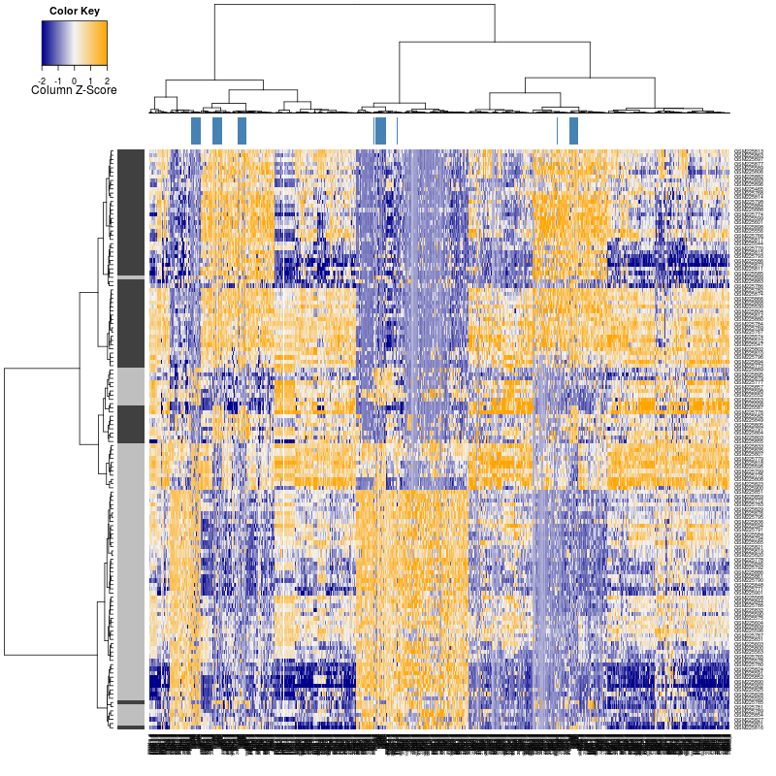
More stringent selection
Generated probes
Information curve
Cut at 70%
56507 rejected probes (~ 98%)
Adk
Sqk

Slide 28
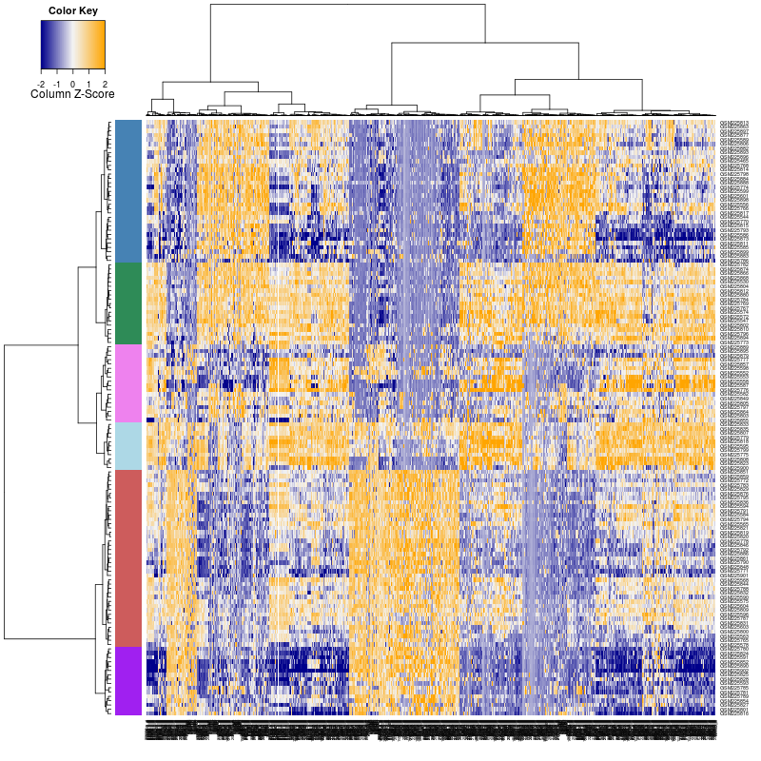
Trying clusters
Samples are clustered into 6 groups, then the probes are tested for these groups.
Results:
1160 of the 1168 probes are significant (adj.p-value ≤ 0.01)

Slide 29
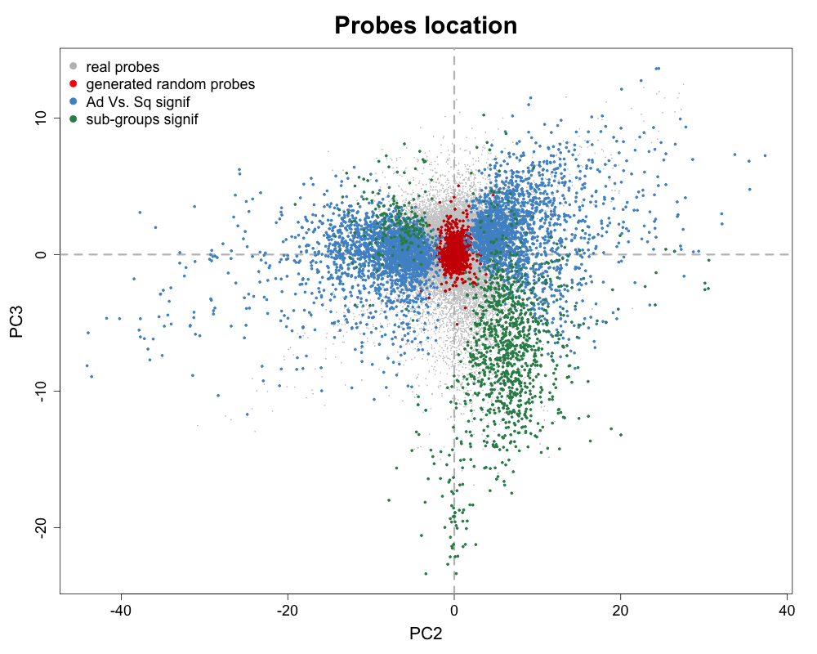
A sub-groups signature?
Non informatives
Dsicriminate
Adk Vs. Sq
Sub-groups

Slide 30
A possible probes space model
PC2 : groups (λ2)
PC3 : sub-groups (λ3)
PC1 : population (λ1)

Slide 31
Using the information curve
to find the best correlated probes.
TCGA – GBM, LUSC, OV
RNASeq Vs. HGU-133

Slide 32
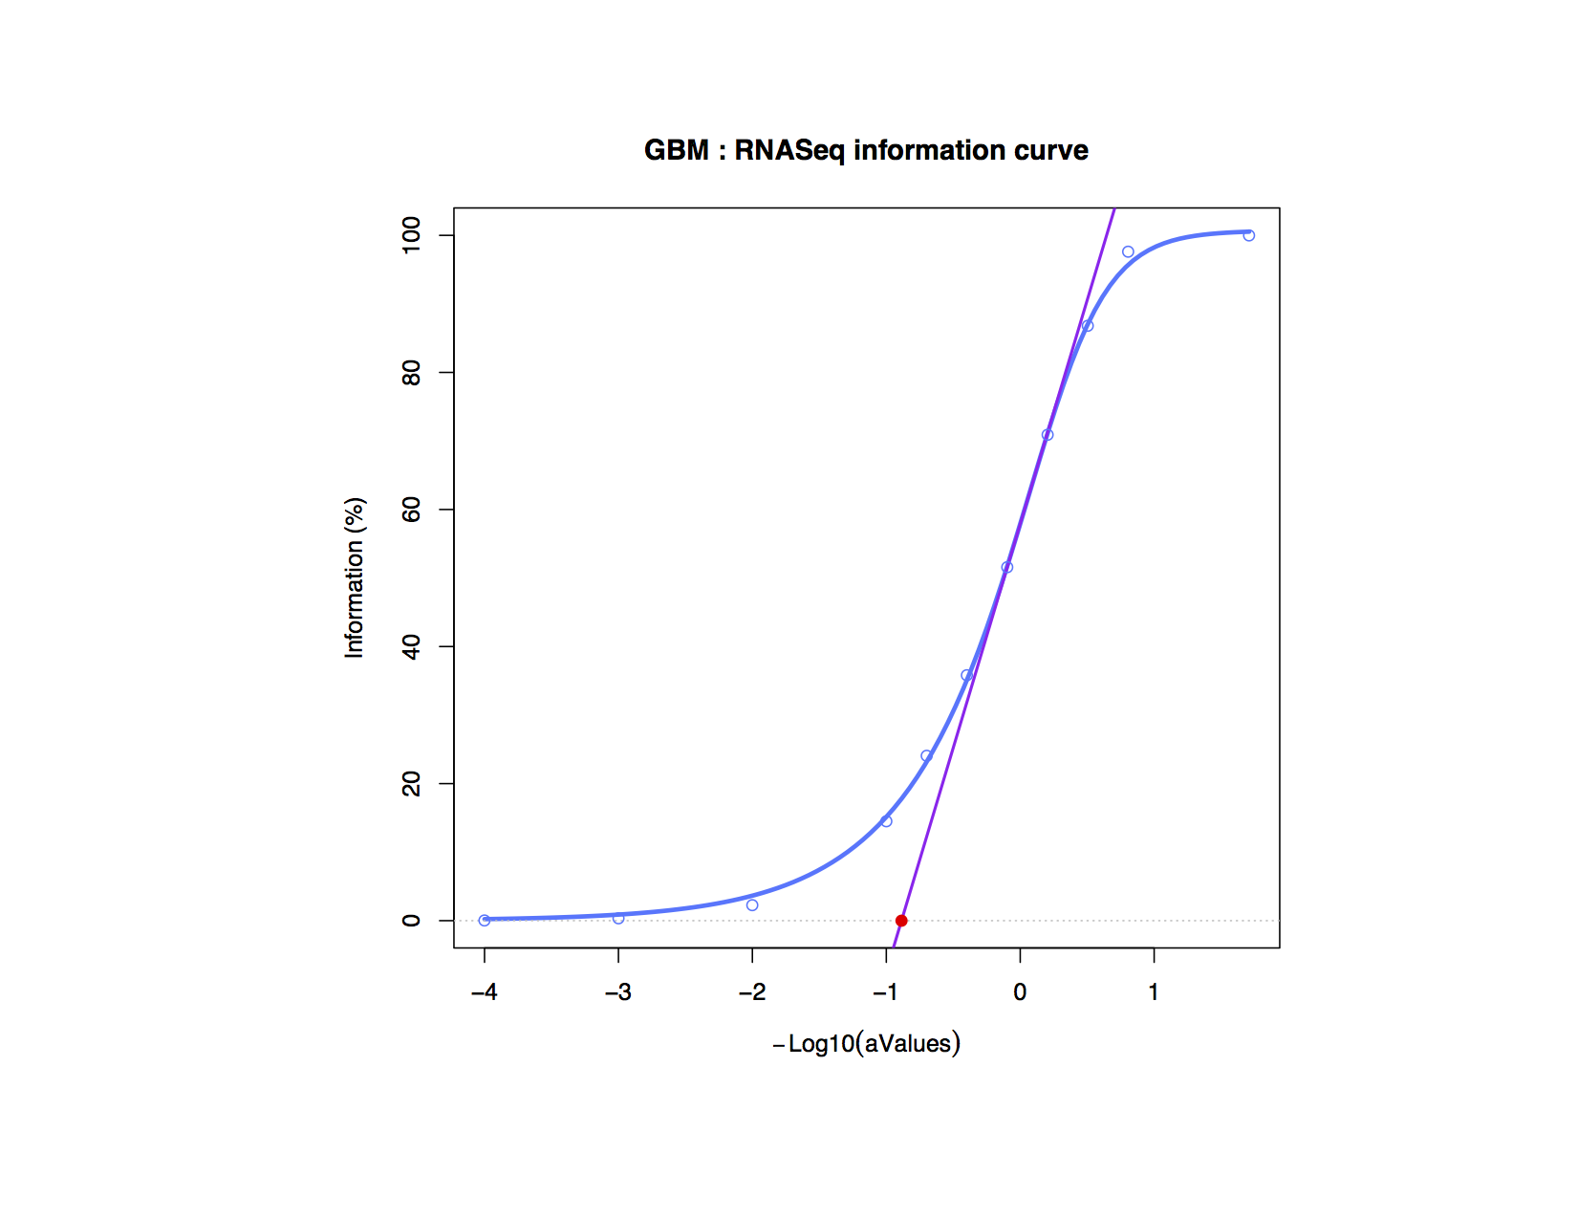
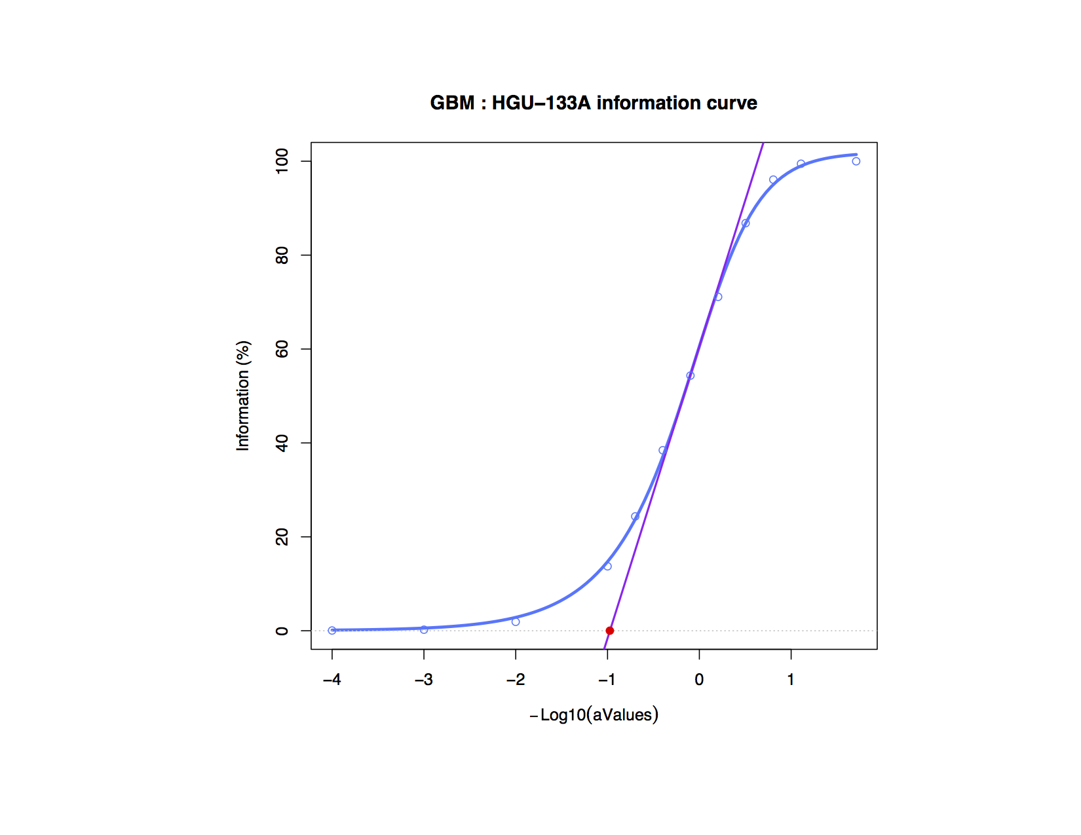
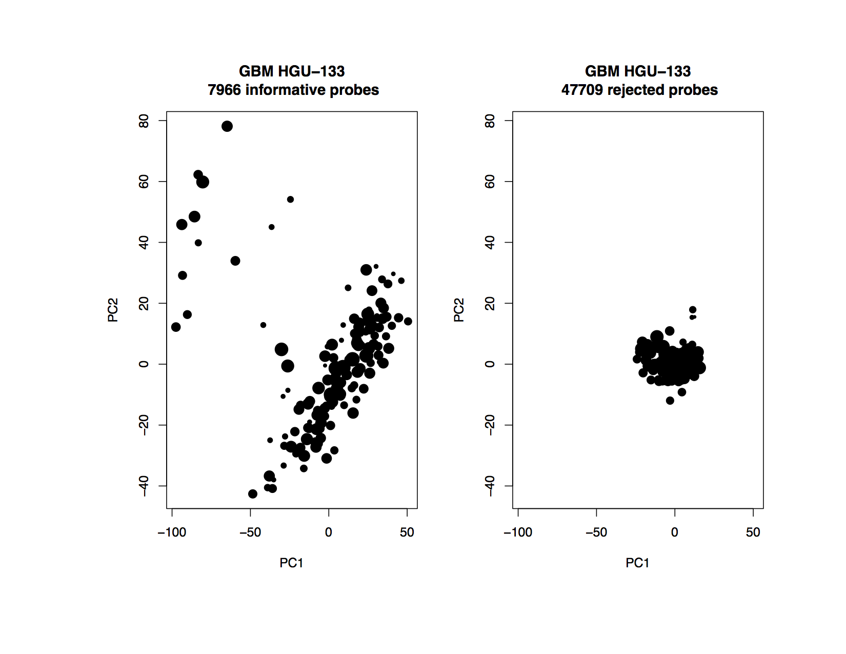
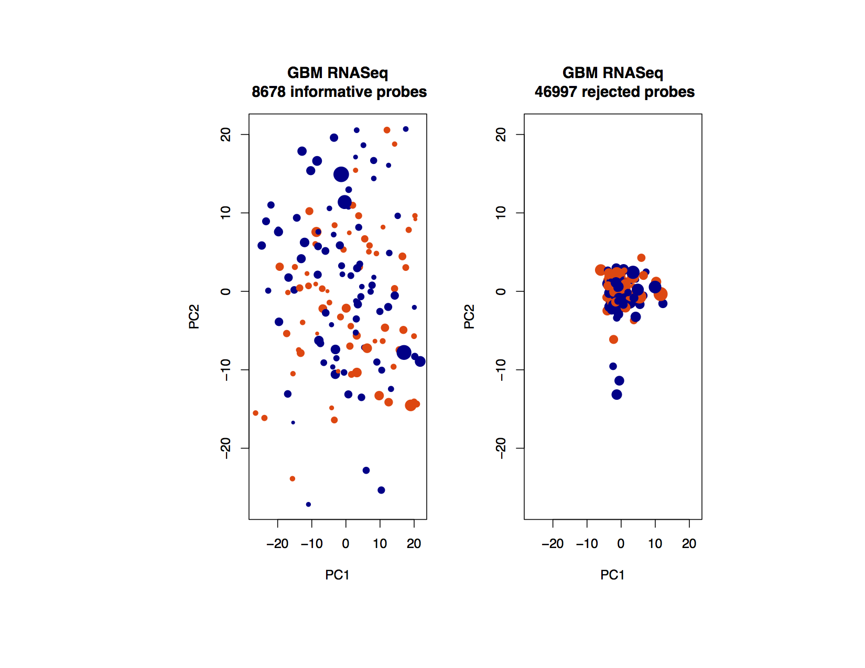

Slide 33
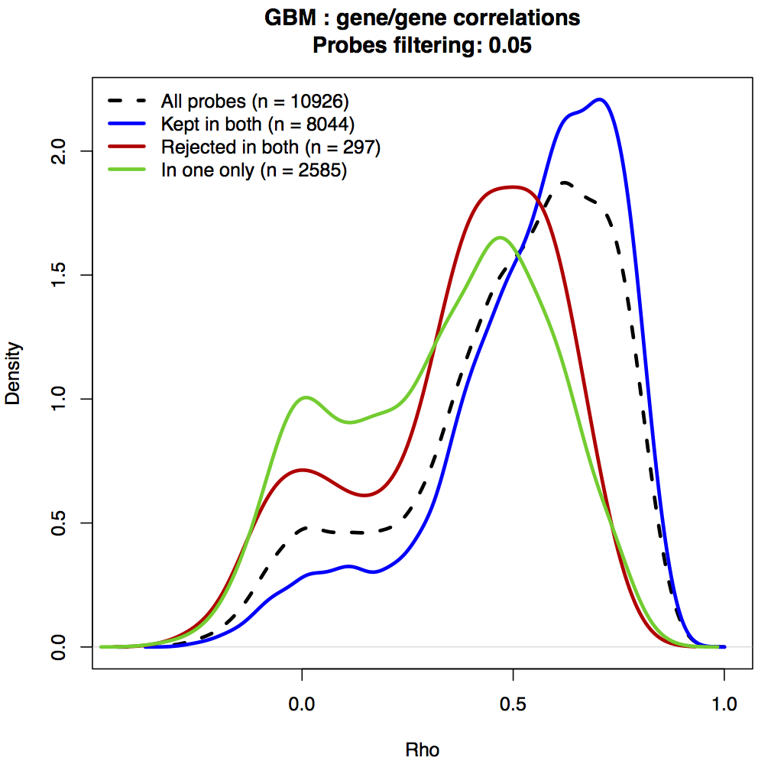

Slide 34
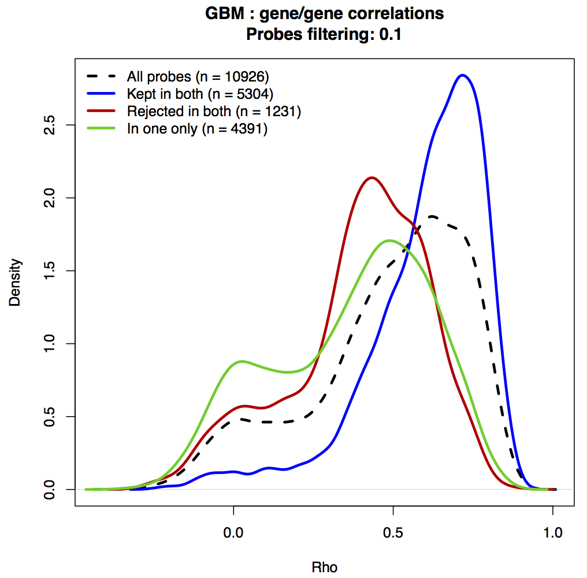

Slide 35
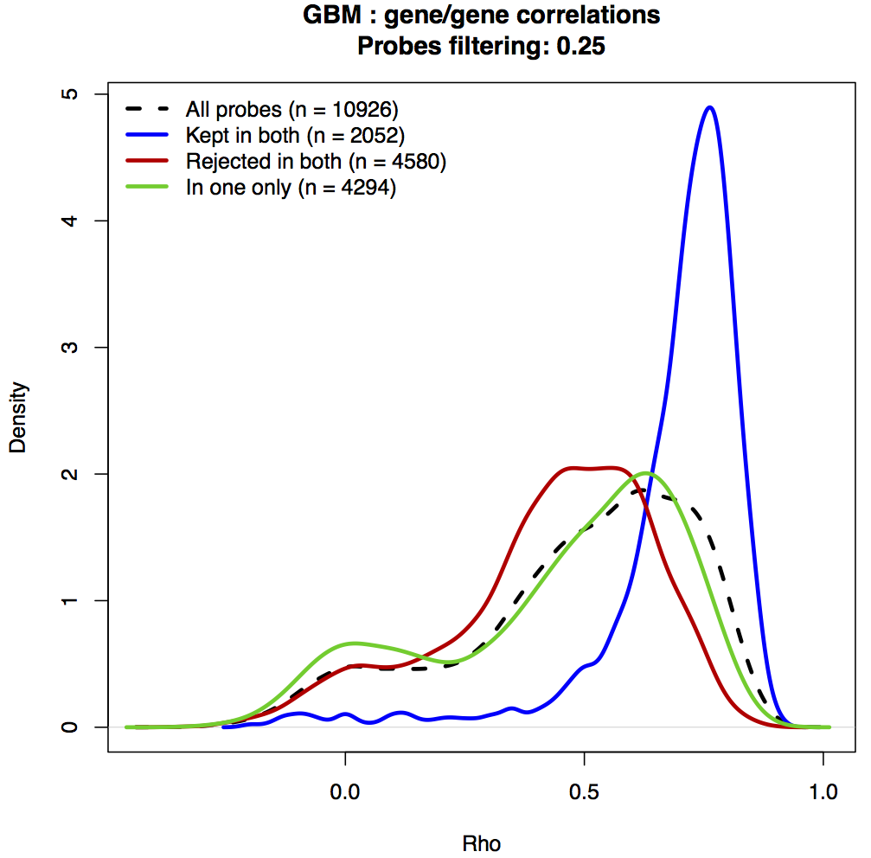

Slide 36
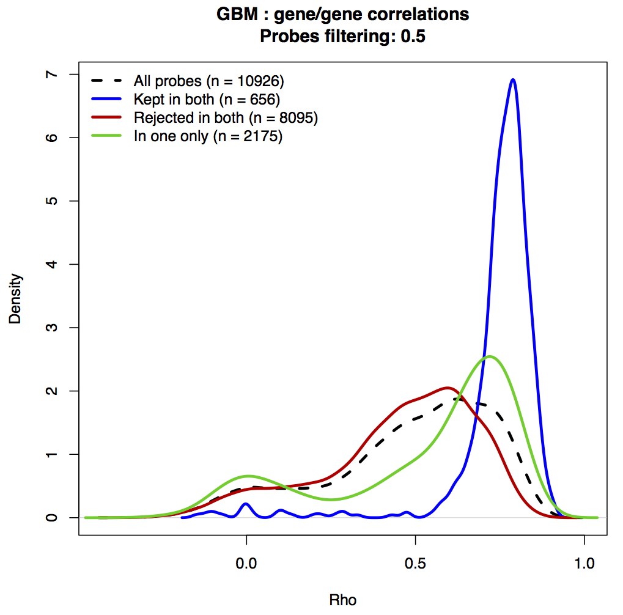

Slide 37
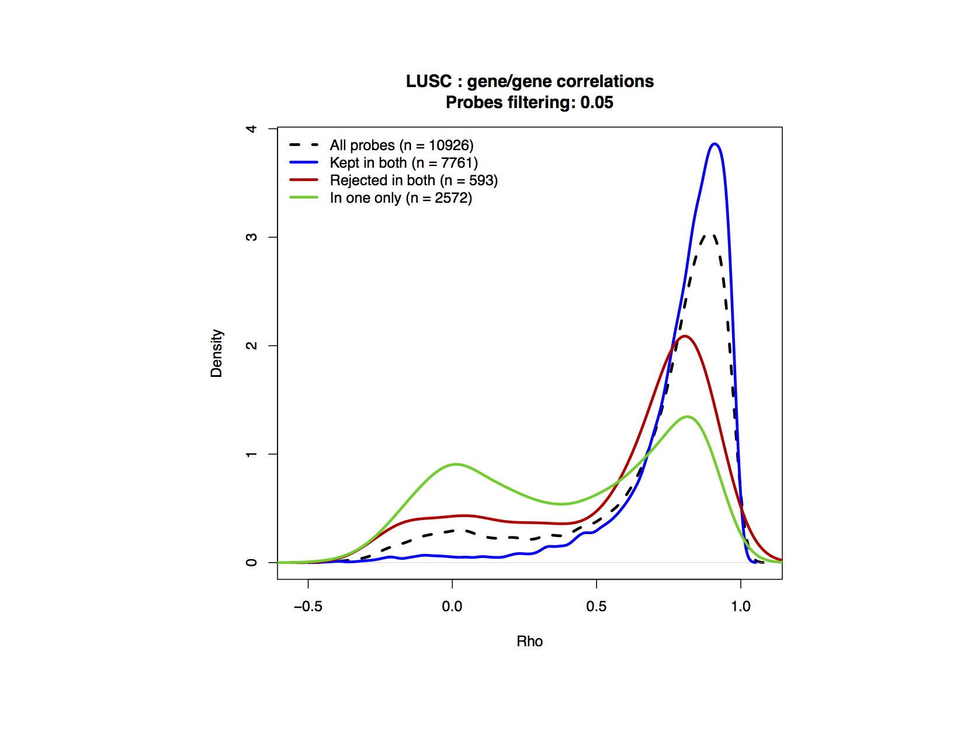
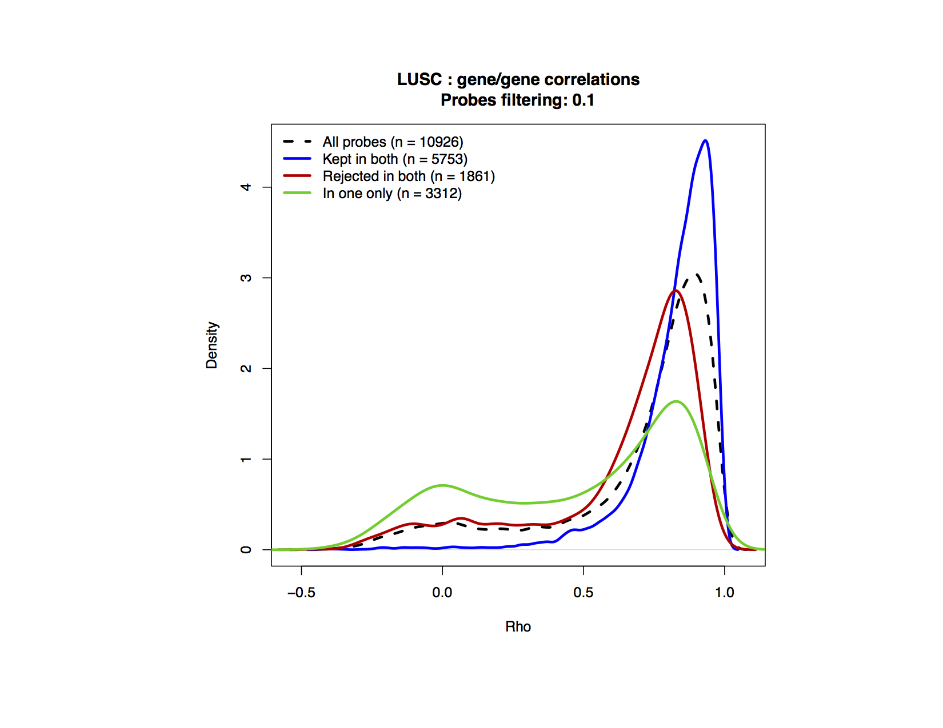
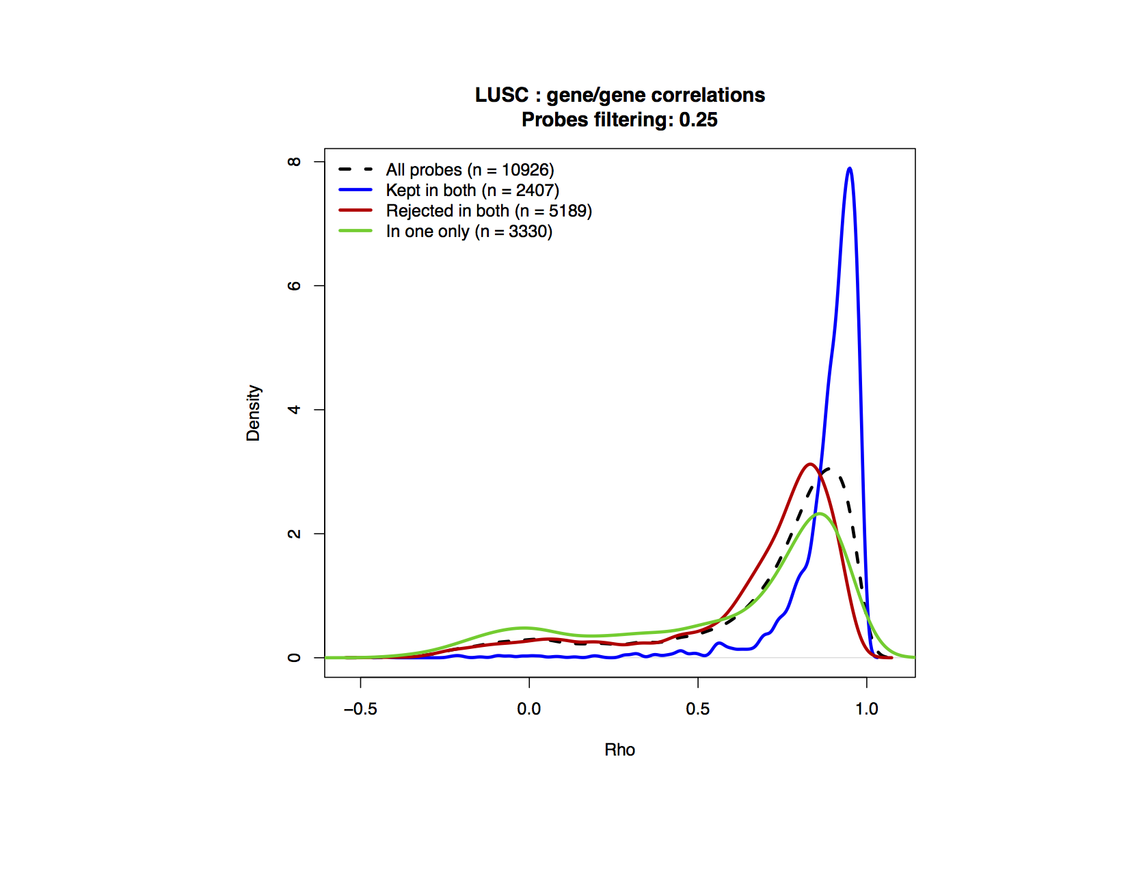
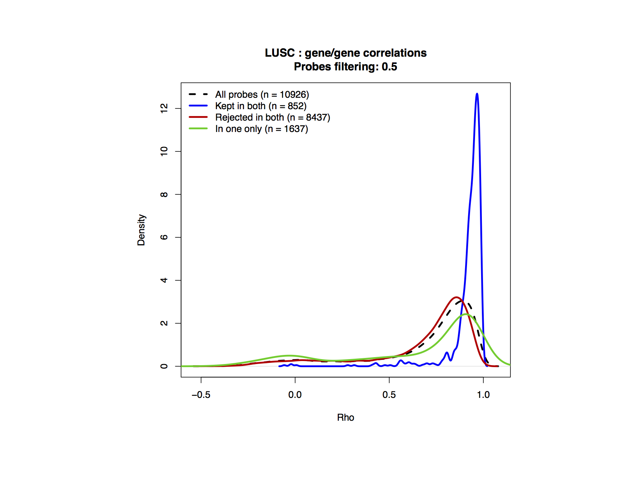

Slide 38
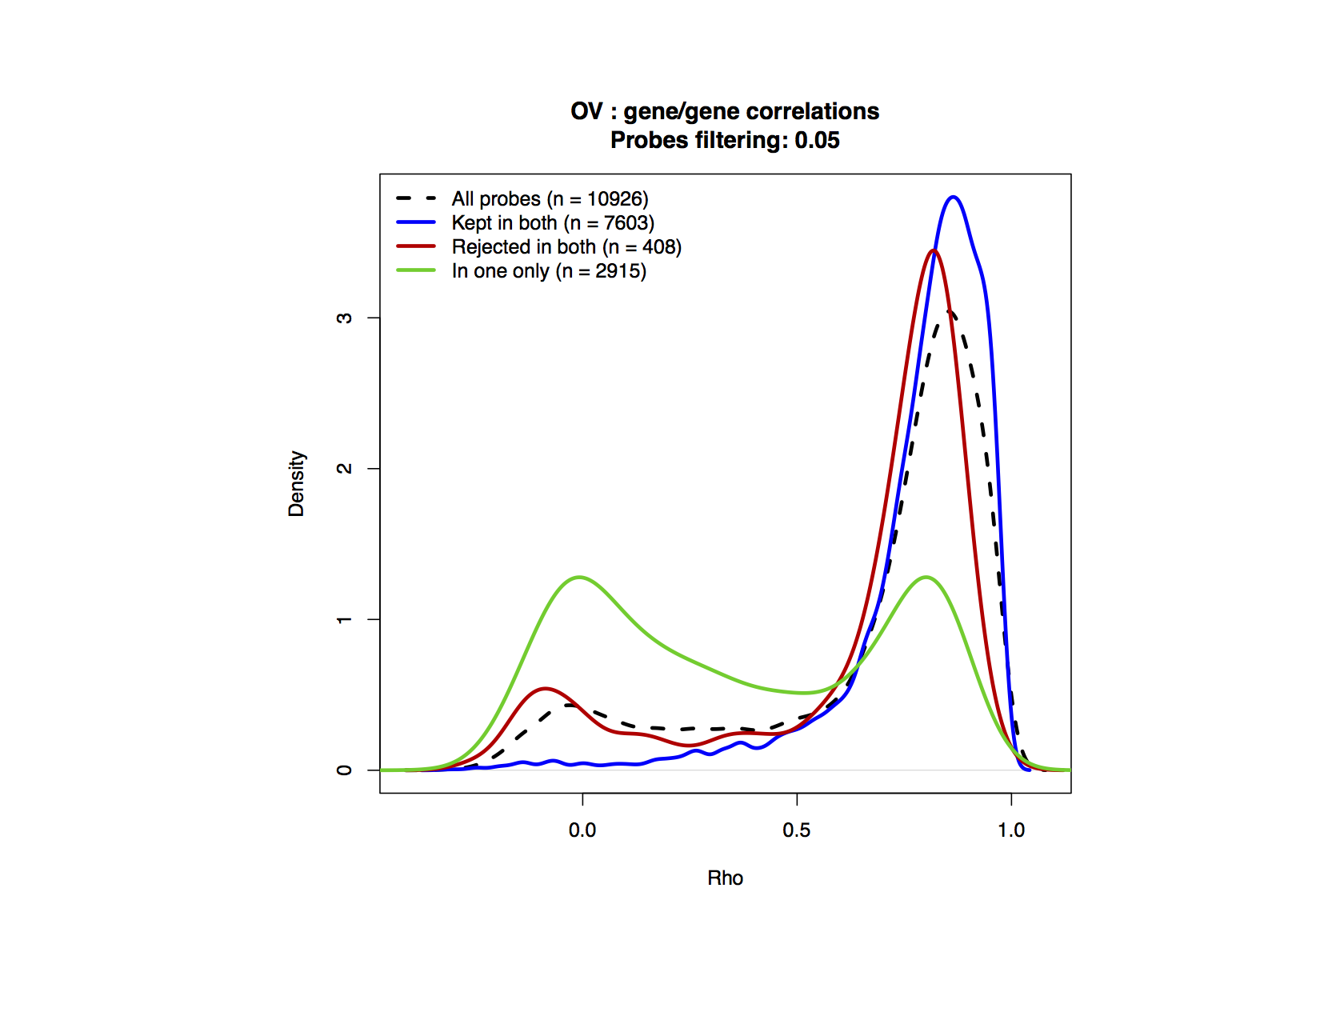
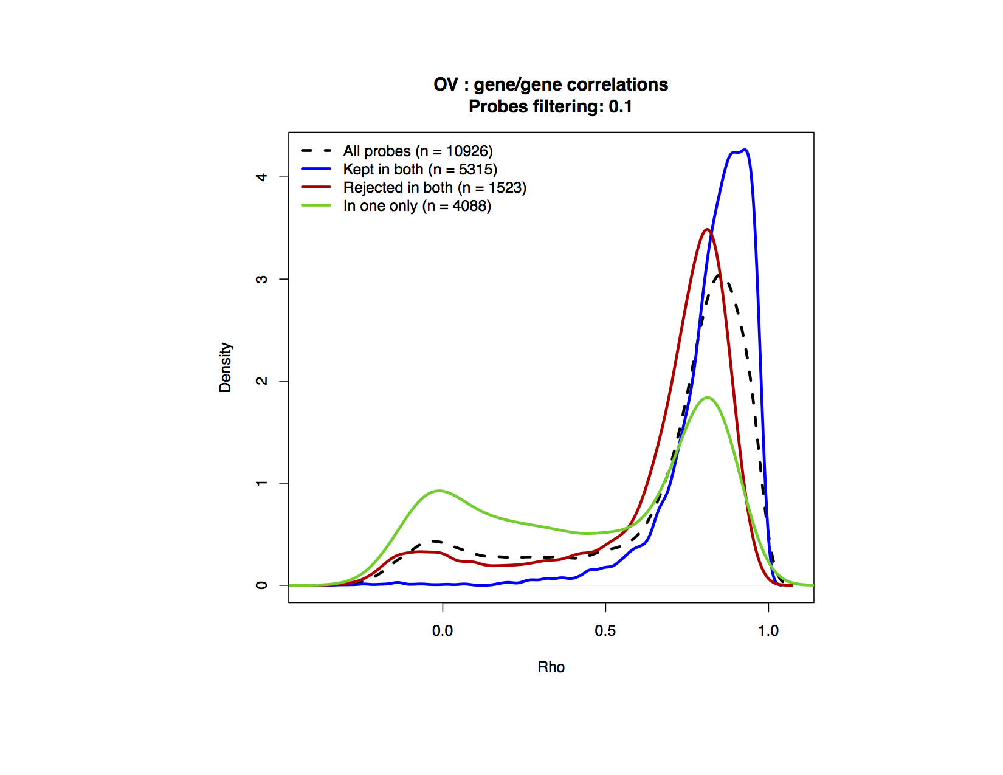
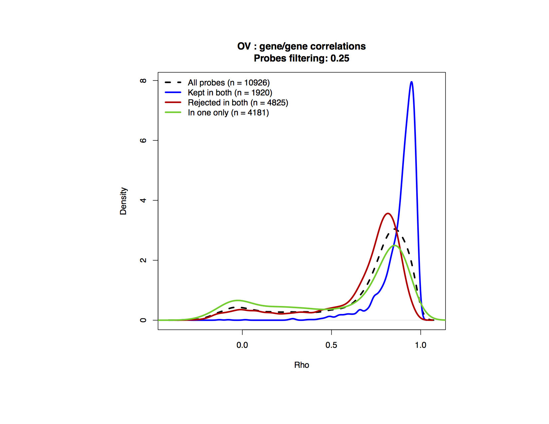
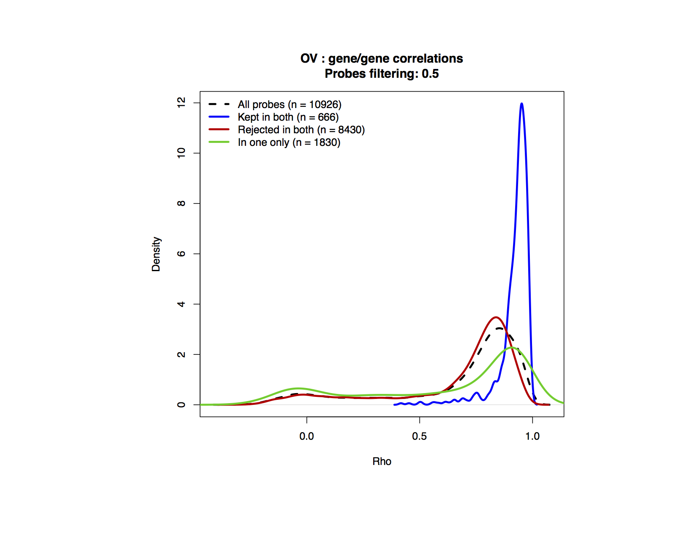

Slide 39
Using the information curve
to improve cell sensitivity signature.
CCLE

Slide 40
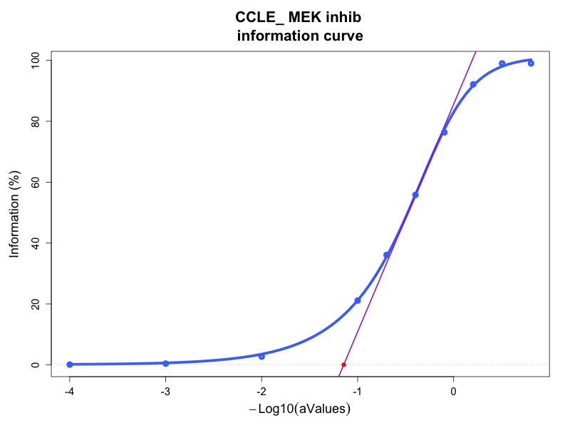

Slide 41
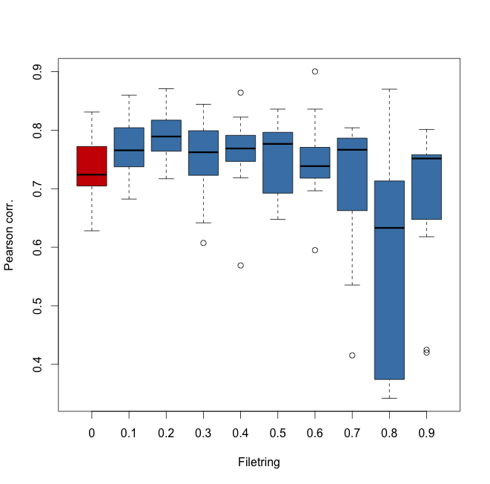
Pearson correlation Observed Vs. fitted values
According to filtering

Slide 42
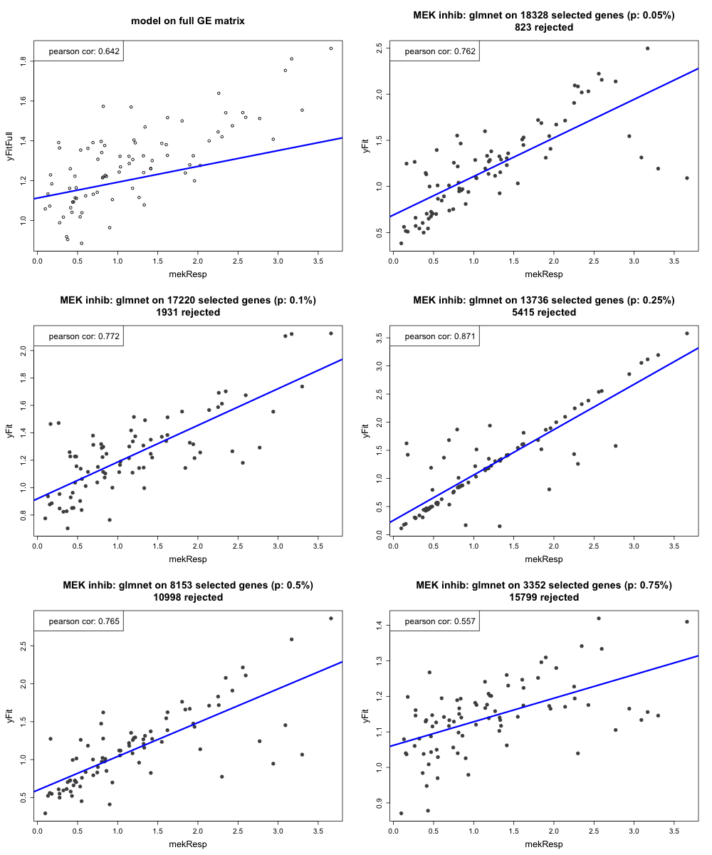

Slide 43
Conclusion
The PCA-based filtering method provides:
- A metric to filter the informative probes
- A model to describe the probes space
- Allow to identify sub-group signatures

